Slide 1
PHARMACOLOGY
A Brief History...

Slide 2
Pharmacology Defined
THE STUDY OF the history, sources, and properties of DRUGS and how they affect the body
* A need for veterinary pharmacology and veterinary colleges came about in the 1700’s when large animals, which were the sources of food and transportation, were killed by epidemics. People did not know how to properly medicate the animals.
* France began opening veterinary colleges in the 1760’s and the U.S. followed ~100 years later with the first school in Philadelphia.

Slide 3
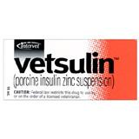
Medicines at that time were derived from plants, which
has since expanded to other sources :
Minerals – examples: iron, calcium, electrolytes
Molds, bacteria – example: Penicillin is a mold (Penicillium notatum)
that has antibacterial properties
Animals – example: hormones such as insulin come from animals (pig)
Synthetic (man-made) – steroids, aspirin
The majority of drugs produced today are synthetic or semi-synthetic (modified from a natural source).

Slide 4
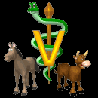
Aspects of PHARMACOLOGY
PHARMACOTHERAPY – TREATMENT of diseases with MEDICINES/DRUGS
PHARMACOTHERAPEUTICS – the field of science that studies the treatment of diseases with medicines/drugs

Slide 5
ASPECTS OF PHARMACOLOGY
PHARMACOKINETICS – MOTION of the drugs through the body (absorption, distribution, biotransformation, excretion).
WHAT HAPPENS TO THE DRUG ONCE IT IS IN THE BODY?
PHARMACODYNAMICS – MECHANISMS OF ACTION of drugs and the physiological and biochemical EFFECTS ON THE BODY.
HOW DOES THE DRUG WORK?

Slide 6
TIMELINE OF PHARMACOLOGY
* Before 1906: There was very little regulation of drugs/medicines. Each state differed in its control over food and drugs and misbranding was a problem.
* 1906: The FDA (Food and Drug Administration) is formed and the Pure Food and Drug Act is established which set standards for drug strength, purity, and focused heavily on how drugs should be labeled. Some improvements were seen, but the FDA was small and their authority was limited and the availability of drugs was limited. There were major problems with dosing/toxicities as proper testing was not performed.

Slide 7
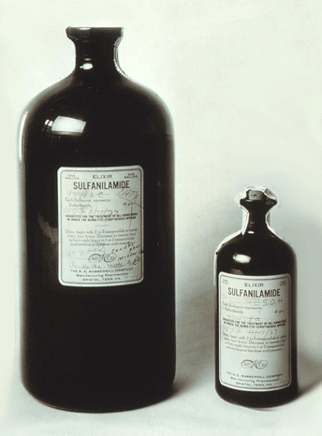
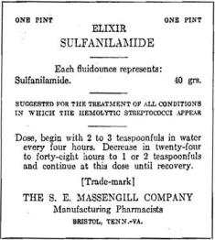
SULFANILAMIDE ELIXER
“Taste of raspberries… taste of death”

Slide 8
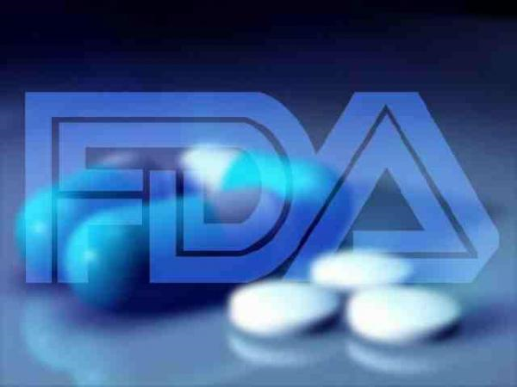
1938: The Food, Drug, and Cosmetic Act was passed. Drugs needed to be tested for safety and labeled adequately for safe use. It also mandated pre-market approval of all new drugs. Manufacturers had to prove to FDA that a drug were safe before it could be sold.

Slide 9
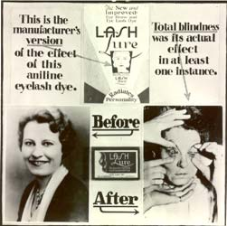
http://www.fda.gov/oc/history/historyoffda/section2.html

Slide 10

CVM’s official logo
Further changes included adding a veterinary medical branch of the FDA, which later became the Center for Veterinary Medicine (CVM). The CVM controls animal drugs, food additives, feed ingredients, and marketed animal devices.
Subsequent amendments were added for New Animal Drugs that required manufacturers to prove that their drug is safe for animals and does what the label states.
Also, manufacturers of drugs used on large animals need to test for drug residues and provide a withdrawal period so that dairy, poultry, and meat products that are consumed by people are drug free.

Slide 11
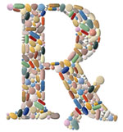


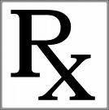
PRESCRIPTION
DRUGS
Drugs that are regulated by the FDA and are limited to use under the supervision of a veterinarian or physician. They must come with a label that reads:
“CAUTION: Federal law restricts the use of this drug to use by or on the order of a licensed veterinarian”.
They are regulated because of their potential danger, toxicity, administration difficulty, etc. Prescription drugs can only be obtained through a veterinarian OR via a prescription from one. In order to receive a prescription, a VETERINARIAN/CLIENT/PATIENT RELATIONSHIP must be in place.

Slide 12
VETERINARIAN/CLIENT/PATIENT
RELATIONSHIP
A VCPR exists when an animal has been examined by a veterinarian who assumes responsibility for making judgments about the animal’s health and the need for treatment, the client agrees to follow the given instructions, and a veterinarian is available for follow-up. These must all be in place for a VPCR to exist.

Slide 13
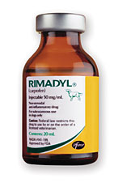
Using a drug OFF-LABEL or EXTRA-LABEL means to use a drug
in a manner that is not described on the FDA label for a particular
disease/condition in a particular species.
This is allowed under the
ANIMAL MEDICINAL DRUG USE CLARIFICATION ACT (AMDUCA)
Of 1994. These drugs must be prescribed by a veterinarian and used
within a VCPR and cannot leave residues in food-producing animals.
Example: Rimadyl in cats is used by a number of veterinarians.
However the U.S. label states:
“WARNINGS: Keep out of reach of children. Not for human use.
Consult a physician in cases of accidental human exposure.
For use in dogs only. Do not use in cats.”

Slide 14
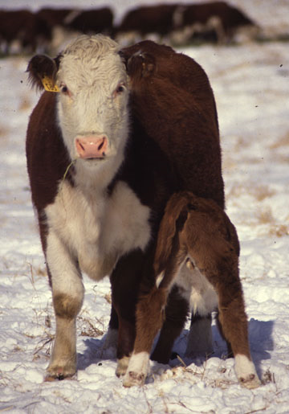
Categories of Drug Products
Copyright © 2011 Delmar, Cengage Learning
Food Animal Residue Avoidance Bank (FARAD)
FARAD is a computer-based system designed to provide information on how to avoid drug, pesticide, and environmental contaminant residue problems
FARAD contains current label information including withdrawal times of drugs, official tolerances, scientific articles, pharmacokinetics, and the fate of chemicals in food animals
FARAD also provides a list of drugs prohibited for use in livestock

Slide 15
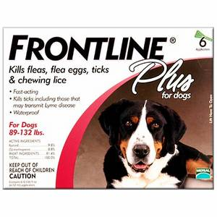
OVER THE COUNTER DRUGS
Drugs that do not require a prescription because there is not significant potential for toxicity.
Example: Frontline
(required a prescription at one point)

Slide 16
CONTROLLED SUBSTANCES
Drugs that are considered to be dangerous because of the potential for human misuse or abuse.
They are regulated by the DRUG ENFORCEMENT ADMINISTRATION (DEA) via the CONTROLLED SUBSTANCES ACT of 1970. Before this act, drug abuse was defined as the illicit use of an illegal drug or the improper use of a prescription drug.
After 1970, controlled substances were classified into 5 schedules that are based on the potential for abuse. The higher the number (schedule), the lower the risk for abuse.

Slide 17
DRUG SCHEDULE | SCHEDULE DEFINITION | EXAMPLES OF DRUGS
Schedule I (C-I) | High potential for abuse, no accepted medical use. MOST DANGEROUS | Heroin, LSD Marijuana
Schedule II (C-II) | High potential for abuse, accepted medical use with severe restrictions | Cocaine, morphine, amphetamines, codeine, pentobarbital, fentanyl,
Schedule III (C-III) | Less potential for abuse, accepted medical uses | Acetominophine/ codeine combos, ketamine, thiopental, hydrocodone
Schedule IV (C-IV) | Low potential for abuse, accepted medical uses | Diazepam, phenobarbital, butorphanol
Schedule V (C-V) | Lowest potential for abuse, accepted medical uses | Buprenorphine, codeine cough syrups

Slide 18
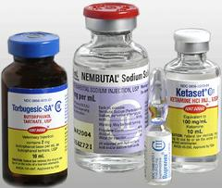
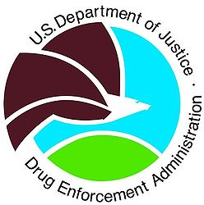
While the FDA regulates the development and approval of drugs, the DEA regulates the laws and rules pertaining to the purchase, storage and use of controlled substances.
Veterinarians who want to use controlled substances in their clinics must register with the DEA.
The DEA requires controlled substances to be stored in a locked cabinet or safe. Any address changes are to be reported to the DEA. A log is kept of all orders, receipts, uses, discards, and thefts for 2 years. Inventory is filed with the DEA every 2 years.

Slide 19
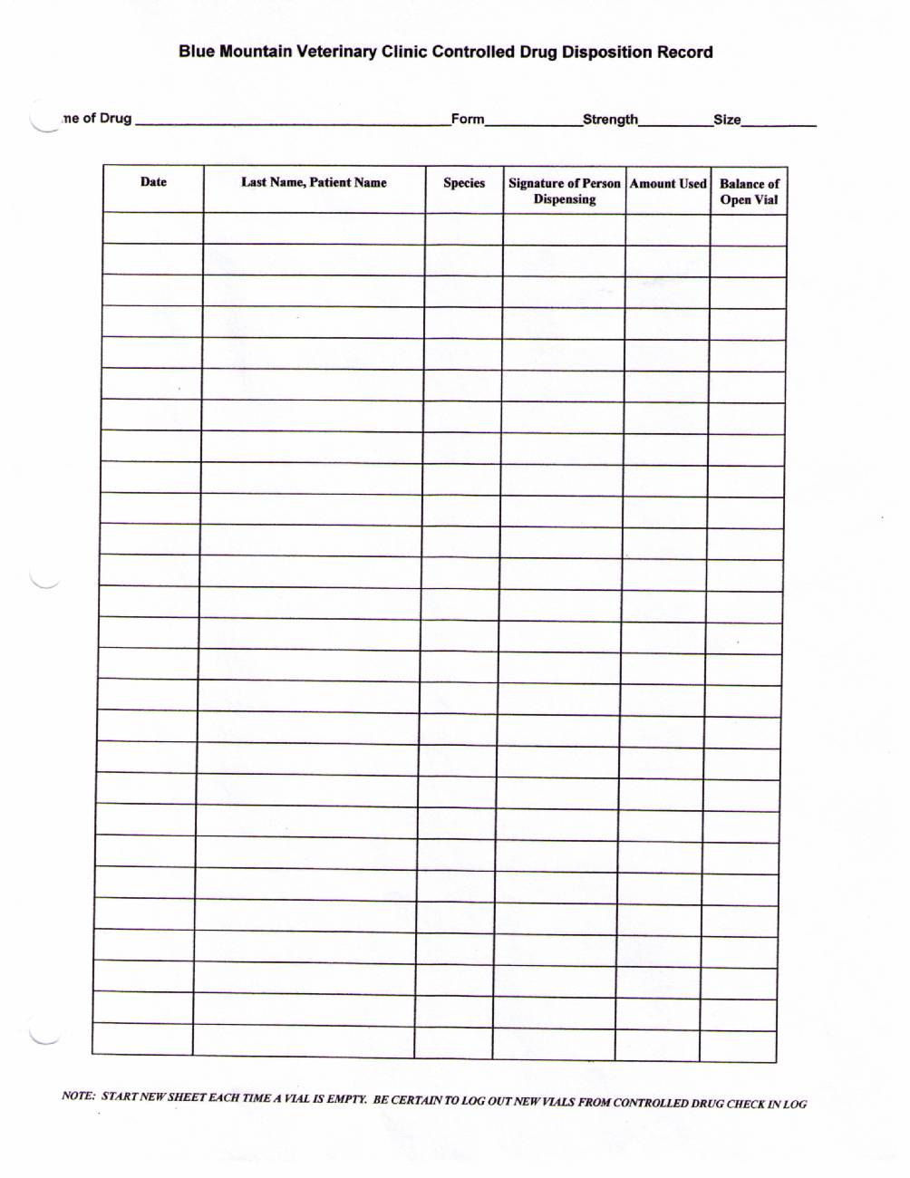
Sample Controlled Substances log

Slide 20
CHAPTER REVIEW
___ drugs that can be purchased without a prescription A) pharmacodynamics
___ drugs considered dangerous because of their potential for B) controlled substances
Human abuse C) pharmacokinetics
___ drugs that can be obtained only through a veterinarian or D) over the counter drug
Via a prescription E) pharmacotherapy
___ drugs used in a manner not specifically described on the F) prescription drugs
FDA- approved label G) extra-label drugs
___ study of a drug’s mechanism of action and its biological H) vet. pharmacology
And physiological effects I) FDA-CVM
___ study of the absorption, blood levels, distribution, metabolism,
And excretion of drugs J) Animal Medicinal Drug
___ the treatment of disease with medicines Use Clarification Act of
___ the study and use of drugs in animal health care 1994
___ the law that allows extra-label use of a drug under certain
Conditions
___ agency that ensures that approved veterinary medicines are
Relatively safe for animals

Slide 21
CHAPTER REVIEW CONT’D
1)The FDA became a government agency after the passage of the
a) federal Food and Drug Act of 1906
b) Controlled Substances Act of 1970
c) Food, Drug, and Cosmetic Act of 1938
2)A person studying how the body absorbs, uses, and gets rid of codeine is engaged in the pharmacological specialty called
a) pharmacotherapeutics
b) pharmacodynamics
c) pharmicokinetics

Slide 22
CHAPTER REVIEW
3) Controlled substances must
a) be kept in a locked cabinet or safe
b) have orders, receipts, uses, and thefts recorded
c) be ordered by veterinarians who register annually with the DEA
d) All of the above
4) The higher (larger) the schedule number of a controlled substance drug
a) the higher the risk for human abuse potential
b) the lower the risk for human abuse potential
c) the less medical value it has

Slide 23
CHAPTER REVIEW
TRUE OR FALSE
Prescription drugs are limited to use under the supervision of a veterinarian or physician.
The majority of veterinary drugs in use during the early 1900s were found naturally in plants
The major requirement of the Food, Drug, and Cosmetic Act of 1938 is the requirement of drug safety
Diazepam (Valium) is an example of a schedule I drug
Over the counter drugs are approved for human use only by the FDA

Slide 24
THE FOLLOWING IS THE PART OF THE PACKAGE INSERT FOR RIMADYL…..
Can you identify which section refers to PHARMACODYNAMICS and which refers to PHARMACOKINETICS?

Slide 25
CLINICAL PHARMACOLOGY: Carprofen is a non-narcotic, non-steroidal anti-inflammatory agent with characteristic analgesic and antipyretic activity approximately equipotent to indomethacin in animal models. The mechanism of action of carprofen, like that of other NSAIDs, is believed to be associated with the inhibition of cyclooxygenase activity. Two unique cyclooxygenases have been described in mammals. The constitutive cyclooxygenase, COX-1, synthesizes prostaglandins necessary for normal gastrointestinal and renal function. The inducible cyclooxygenase, COX-2, generates prostaglandins involved in inflammation. Inhibition of COX-1 is thought to be associated with gastrointestinal and renal toxicity while inhibition of COX-2 provides anti-inflammatory activity. The specificity of a particular NSAID for COX-2 versus COX-1 may vary from species to species. In an in vitro study using canine cell cultures, carprofen demonstrated selective inhibition of COX-2 versus COX-1. Clinical relevance of these data has not been shown. Carprofen has also been shown to inhibit the release of several prostaglandins in two inflammatory cell systems: rat polymorphonuclear leukocytes (PMN) and human rheumatoid synovial cells, indicating inhibition of acute (PMN system) and chronic (synovial cell system) inflammatory reactions. Several studies have demonstrated that carprofen has modulatory effects on both humoral and cellular immune responses. Data also indicate that carprofen inhibits the production of osteoclast-activating factor (OAF), PGE1, and PGE2 by its inhibitory effect in prostaglandin biosynthesis.
Based upon comparison with data obtained from intravenous administration, carprofen is rapidly and nearly completely absorbed (more than 90% bioavailable) when administered orally. Peak blood plasma concentrations are achieved in 1–3 hours after oral administration of 1, 5, and 25 mg/kg to dogs. The mean terminal half-life of carprofen is approximately 8 hours (range 4.5–9.8 hours) after single oral doses varying from 1–35 mg/kg of body weight. After a 100 mg single intravenous bolus dose, the mean elimination half-life was approximately 11.7 hours in the dog. Rimadyl is more than 99% bound to plasma protein and exhibits a very small volume of distribution. Carprofen is eliminated in the dog primarily by biotransformation in the liver followed by rapid excretion of the resulting metabolites (the ester glucuronide of carprofen and the ether glucuronides of 2 phenolic metabolites, 7-hydroxy carprofen and 8-hydroxy carprofen) in the feces (70–80%) and urine (10–20%). Some enterohepatic circulation of the drug is observed.

